Slide 1

Introduction to Computing and Programming in Python™: A Multimedia Approach
Fourth Edition
Chapter 12
Advanced Text Techniques: Web and Information
Slides in this presentation contain hyperlinks. JAWS users should be able to get a list of links by using INSERT+F7
Copyright © 2016, 2013, 2010 Pearson Education, Inc. All Rights Reserved
Notes:
If this PowerPoint presentation contains mathematical equations, you may need to check that your computer has the following installed:
1) MathType Plugin
2) Math Player (free versions available)
3) NVDA Reader (free versions available)
Thanks to John Sanders of Suffolk University for contributions to these slides!

Slide 2
Learning Objectives
12.1 To write programs to directly access and use text information from the Internet.
12.2 To translate a sound or picture to text and translate text back to a sound or picture.
12.3 To hide a message (text or audio) in a picture.
12.4 To write a program to access the Internet and return processed information.
12.5 To show that information can be encoded in many ways.

Slide 3
Networks: Two or More Computers Communicating
Networks are formed when distinct computers communicate via some mechanism.
Rarely does the communication take the place of
voltages over a wire.
Too hard to make work over distances
More common is the use of frequencies (maybe in the sound range, but maybe not).
For example, a modem (modulator-demodulator) takes your computer’s 0’s and 1’s and translates them into sound frequencies that can pass over the sound wire and be decoded on the other side.

Slide 4
Networks, Networks Everywhere
If you’re driving a newer car, you probably have a network in there.
There are lots of computers in your car (controlling air flow, gas flow; making the air bag work) and they communicate.
You can have a network in your own home, or even on an airplane.
Can use radio signals for communication (wireless)
Or can string a cable between two computers.

Slide 5
Networks have Layers
Networks have several layers to them.
At the bottom level is the physical substrate.
What are the signals being passed on?
Levels higher determine how data is encoded.
Do we use sound frequencies to represent 0’s and 1’s, or radio waves?
Do we send a bit at a time? A byte at a time? Or in packets larger than that?
Levels even higher determine the protocol of communication.
How do I address a particular computer I want to talk to? Or many computers?
How do I tell a computer that I want to talk to it? That I’m starting to send it data? What it’s supposed to do with it? When we’re done?

Slide 6
Ethernet: A Common Mid-Level Protocol
Ethernet is a common mid-level protocol.
It specifies some aspects of how data is encoded and computers are specified.
For example, each computer on an Ethernet network has a deep-down inside-the-computer address that identifies it uniquely.
But Ethernet can work over a variety of physical substrates.
For example, you can run Ethernet over wireless (radio) or over coaxial cable (where you hear terms like “10baseT”

Slide 7
Internet: A Collection of Networks
The Internet is a network of networks.
If you put a device in your home so that your computers can talk to one another, you have a network.
A wireless base station, or an Ethernet router, perhaps.
You can probably reach printers on your network, or copy files between computers.
If you now connect your network (through an Internet Service Provider (I S P)) to the global Internet, your network becomes yet another part of the whole Internet.

Slide 8
Internet is Based on Agreements on Encodings
The Internet is built on a set of agreements about:
How computers will be addressed
A set of four numbers (each one byte now, soon to grow) separated by periods, e.g., 10.1.0.5.
A way of associating domain names with these numbers, like www.cnn.com (which really is a name that resolves to a set of four numbers), using domain name servers.
How computers will communicate
That data will be put into packets with various pieces in them.
That computers will format their data and talk to one another using T C P/I P
How packets are routed around the network to find their destination.

Slide 9
The Internet is not New
The Internet agreements date back 40 years.
It was originally set up for military applications.
One of the features of the Internet is that packets find their destination even if part of the Internet is destroyed, damaged, or subject to censorship.
The Internet originally had only a handful of computers (nodes) on it, but it has grown dramatically in recent years.
Notes:
Al Gore was a senator who first understood the value of having an Internet
and fought hard for the funding to make it happen. And yes, the people (like Vinton Cerf) who invented the Internet protocols say that it is reasonable to say that Al Gore invented the Internet.
Al Gore was a senator who first understood the value of having an Internet
and fought hard for the funding to make it happen. And yes, the people (like Vinton Cerf) who invented the Internet protocols say that it is reasonable to say that Al Gore invented the Internet.

Slide 10
Protocols on the Internet
But all that just lets us pass data back and forth.
What does the data say?
What does the data do?
One of the first applications placed on top of the Internet was electronic mail.
The mail protocols have evolved over time to their standard forms today.
The File Transfer Protocol (F T P) allows computers to move files between each other.
It defines what one side says to the other when copying a file over (e.g., “S T O filename”) and how the file will be encoded.

Slide 11
Then there’s the Web
The Web dates only back to the 1980’s, but before there were graphical browsers (like Netscape Navigator, Internet Explorer, and the first, N C S A Mosaic).
The Web is (again) a set of agreements, started by Tim Berners-Lee
On how to refer to everything on the Internet: The U R L (Uniform Resource Locator)
On how to create documents that refer to things all over the Internet: H T T P (HyperText Transfer Protocol)
On how those documents will be formatted: Using H T M L (HyperText Markup Language)

Slide 12
HyperText: Non-Linear Text
Hypertext is a term invented by Ted Nelson in the 1960’s.
It refers to text that is non-linear, which the computer makes possible.
You’re familiar with this on the Web:
Read a little on a page,
Click,
Continue reading on some other page anywhere on the Internet.

Slide 13
The Point of the Web is Hypertext
Tim Berners-Lee wanted a way to create readable documents that could reference material anywhere on the Internet in a hypertext format.
There are technical flaws in what he did:
For example, the phenomena of “dead links” couldn’t happen in other hypertext systems before the Web.
But it worked and has become a worldwide standard.

Slide 14
Hypertext Transfer Protocol (H T T P)
H T T P defines a very simple protocol for how to exchange information between computers.
It defines the pieces of the communication.
What resource do you want?
Where is it?
Okay, here’s the type of thing it is (J P E G, H T M L, whatever), and here it is.
And the words that the computers say to one another:
Not-complex words like “GET”, “PUT” and “OK”

Slide 15
Uniform Resource Locators (U R L)
U R Ls allow us to reference any material anywhere on the Internet.
Strictly speaking, any computer providing a protocol accessible via U R L.
Just putting your computer on the Internet does not mean that all of your files are accessible to everyone on the Internet.
U R L s have four parts:
The protocol to use to reach this resource,
The domain name of the computer where the resource is,
The path on the computer to the resource,
And the name of the resource.

Slide 16
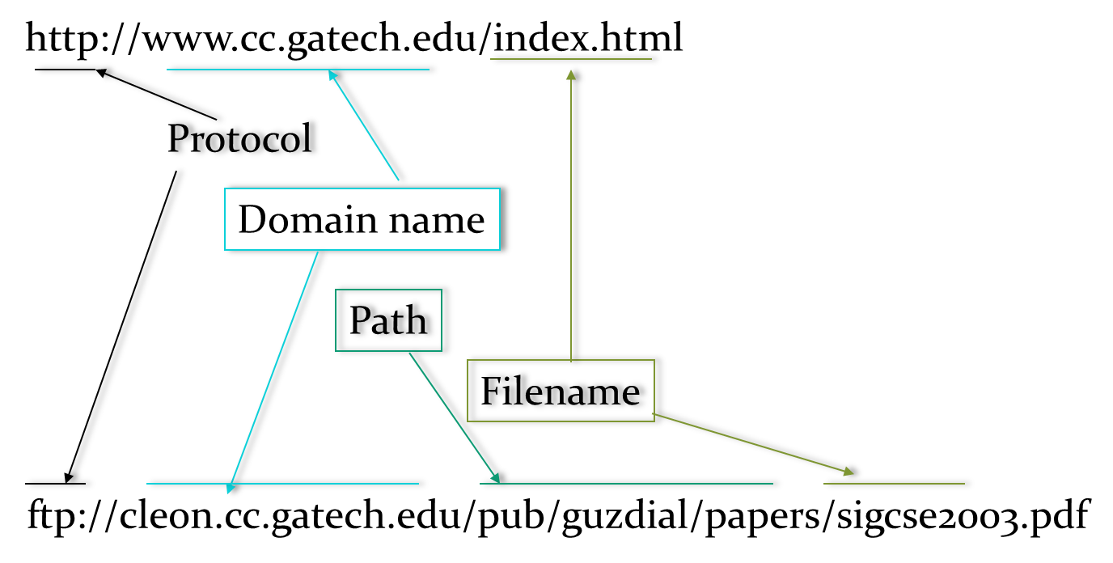
Example U R Ls

Slide 17
What if there is no Path?
Web servers (programs that understand the H T T P protocol) typically have a special directory that they serve from.
Files in that special directory are directly referable without specifying a path.
Sub-directories within the server directory can be accessed in terms of a path.
But always starting from the server directory, so not everything on your computer is always accessible.

Slide 18
A Browser is a Client
Your Web browser is called a client accessing a Web server.
Programs like Internet Explorer or Firefox or Safari understand a lot about Internet protocols.
They know how to interpret H T M L and display it graphically.
If the H T M L references other resources, like J P E G pictures, the client fetches them and displays them where appropriate.
Your client knows the details of the H T T P (and maybe F T P, mailto, gopher…) protocols so that it can request the resources you request.

Slide 19
You Don’t Need a Browser to Use the Internet
Your mail program also understands some Internet protocols.
J E S even knows a little about one of the mail protocols, S M T P (Simple Mail Transfer Protocol), so that it can email homework to your instructor (if it’s set up).
Python (and other languages) have modules that allow you to use these protocols.
In Python, we can read any U R L as if it was a file.

Slide 20
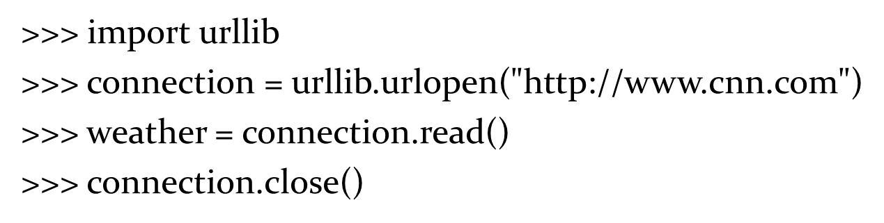
Opening a U R L and Reading it

Slide 21
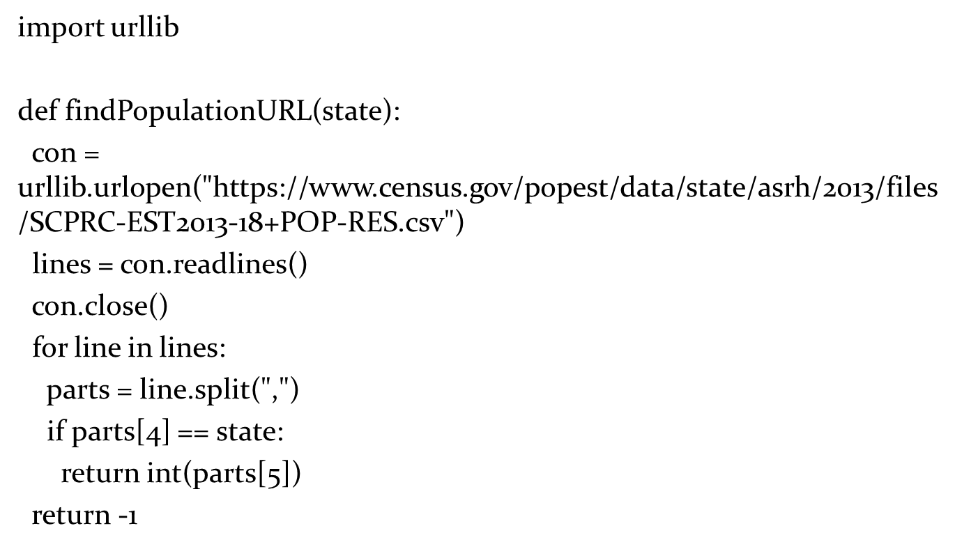
Automating Access to C S V Data

Slide 22
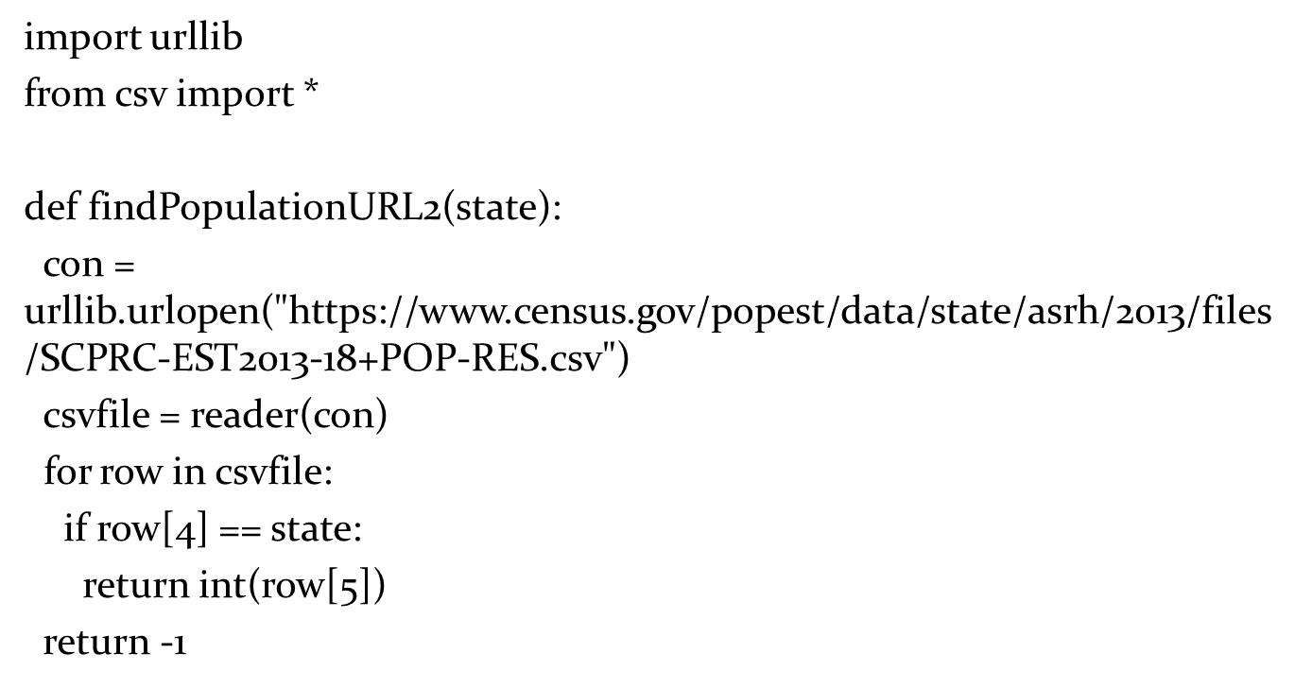
Using U R L and C S V libraries

Slide 23
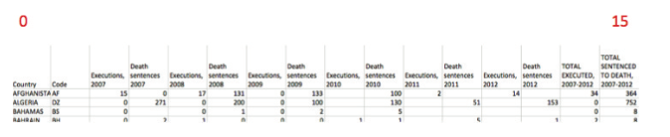
Accessing a C S V File from Disk
Using The Guardian’s dataset on world executions.
Figure 12.1 Format of Death penalty.c s v.

Slide 24
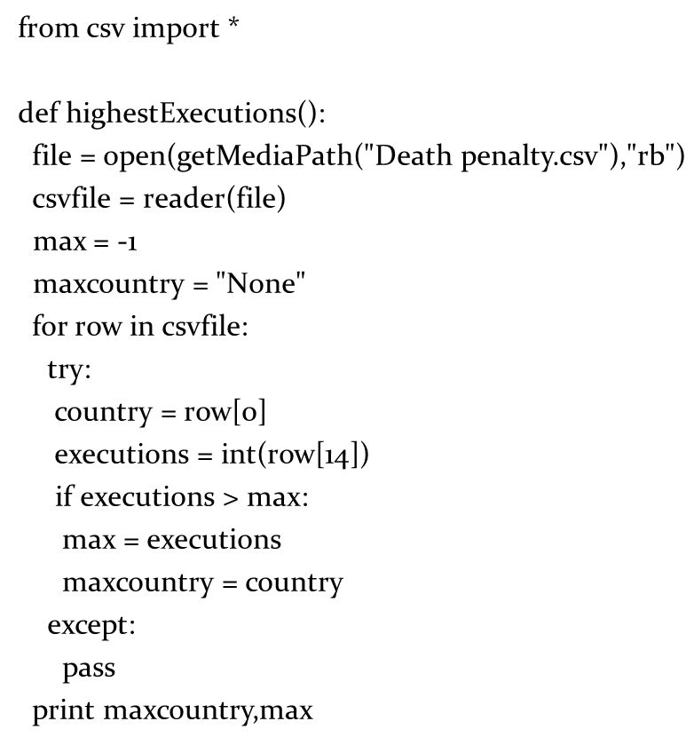

Accessing C S V File from the Guardian

Slide 25
Storing a File is Different
It is possible to send information to a Web server.
That’s how search functions, forms, etc. work.
But it’s more complicated than just reading, and it requires an accepting program on the Web server.
It isn’t hard to send information to an F T P server, though.
But first, let’s make our temperature-finding function useful by directly reading the Weather page…

Slide 26
F T P and H T T P Servers
F T P allows us to move files between computers on the Internet
Including our computer and the computer hosting our H T T P server.
Computers running H T T P servers often also run F T P servers to allow for manipulation of the Web files.
You can do this with specialized F TP clients, or with Python/Jython.

Slide 27
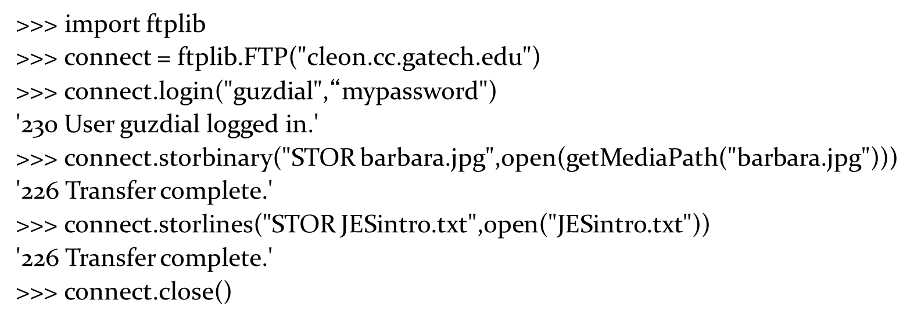
Uploading to an F T P Server

Slide 28
The Interactive Web
The first use of H T T P was just to send around static pages and images (and sounds and…)
Later extensions allowed for users providing input to the server (such as for doing searches).
Originally, this was just “C G I” (Common Gateway Interface) scripts.
Later, servlets and applets and P H P and…

Slide 29
Interactive Web Requires Programs to Generate H T M L
Typically, a Web server will have some directory specified “special.”
Files referenced there aren’t just returned to the client.
Instead, the files are executed and the result is returned to the input.
There’s even a mechanism where the client can provide input to the executed files, e.g., a search string.
Those special files would generate H T M L.
The generated H T M L might be based on up-the-minute information like stock quotes and temperature sensors and database queries.
Thus, to have an interactive Web, we need to write programs that write H T M L.

Slide 30
Using Text to Map Between any Media
We can map anything to text.
We can map text back to anything.
This allows us to do all kinds of transformations:
Sounds into Excel, and back again
Sounds into pictures.
Pictures and sounds into lists (formatted text), and back again.

Slide 31
Why Care About Media Transformations?
Transformed digital media can be more easily transmitted
For example, transfer of binary files over email is often accomplished by converting to text.
We can encode additional information to check for and even correct errors in transmission.
It may allow us to use the media in new contexts, like storing it in databases.
Some transformations of media are made easier when the media are in new formats.

Slide 32
Mapping Sound to Text
Sound is simply a series of numbers (sample values).
To convert them to text means to simply create a long series of numbers.
We can store them to a file to manipulate them elsewhere.

Slide 33
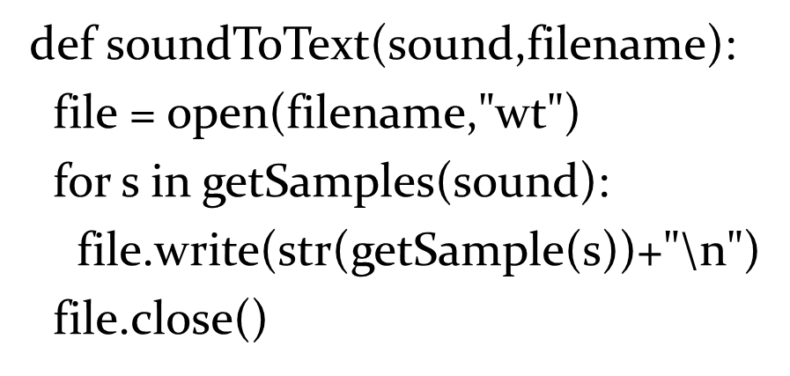
Copying a Sound to Text

Slide 34
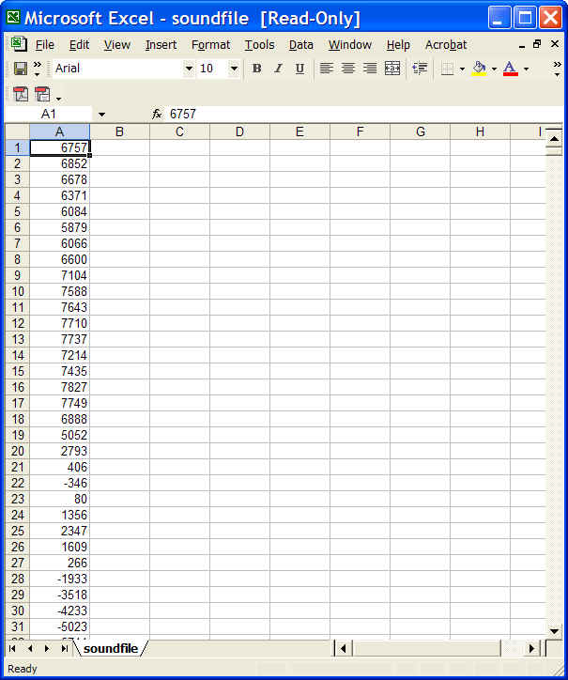
What to do with Sound as Text
What this leaves us with is a long file, containing just numbers.
What knows how to deal with long lists of numbers?
Excel!
We can simply open our text (.txt) file in Excel.

Slide 35
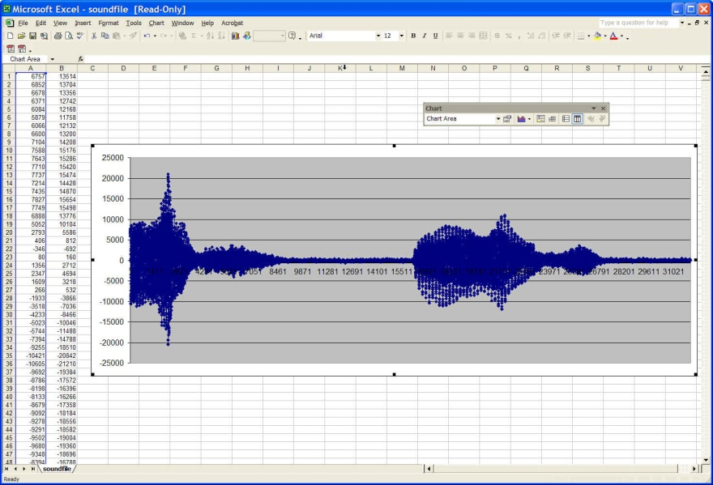
We Can Process the Sound in Excel
We can graph the sound (below)
A signal view is simply the graph of the sample values!
We can add a column and do some modification to the original sound. (Fill down to get them all.)
Can increase the volume that way.

Slide 36
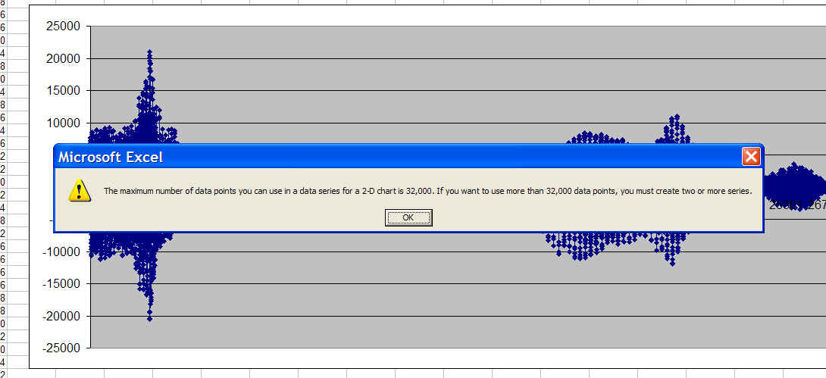
Some Forms of Excel May not Work

Slide 37
Reading Text Back into a Sound
After we process the sound (as text) in Excel, we can save it back to a sound.
First, copy the column you want into a new worksheet
Then, save the worksheet as a .txt file.
Get the full pathname of the new .txt file to use in J E S.

Slide 38
Issues in Reading the Text Back into a Sound
We can’t be sure how many numbers are in the file.
We can’t be sure that the numbers will all fit into the sound we've chosen to serve as our target.
What we want to do is:
AS LONG AS we’re not out of numbers in the file, and AS LONG AS we still have room in the sound,
Copy a number out of the file,
And put it into a sample in the sound,
Then go to the next number and the next sample.

Slide 39
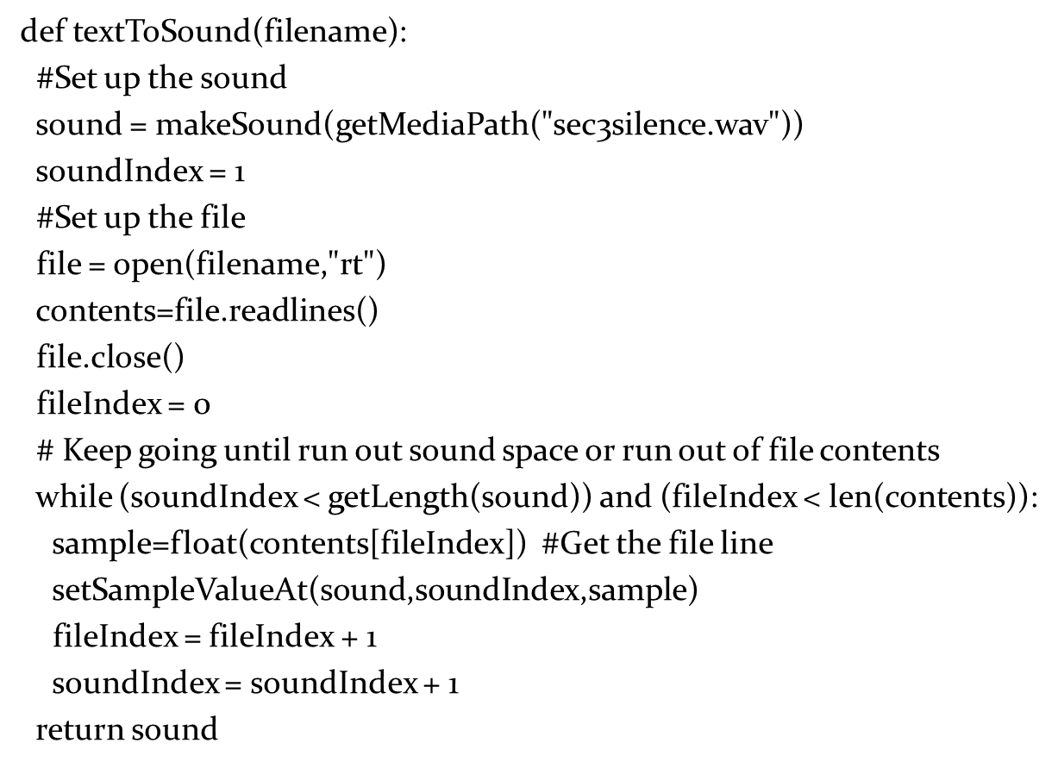
Reading the Text Back as a Sound

Slide 40
While (Soundindex < getLength(Sound)) and (fileIndex < len(Contents)):
Let’s explain this statement:
while – keeps executing the block until the logical expression is false.
(soundIndex < getLength(sound)) – while the index is not yet at the end of the sound, so there’s still room for more numbers.
and – both parts have to be true for the whole thing to be true.
(fileIndex < len(contents)) – while there are any numbers left in the file, i.e., the fileIndex is before the length of the contents of the file.

Slide 41
We Could do Pictures, but More Complicated
Pictures aren’t just a single number for each pixel
To recreate a picture in text we need to record, for each pixel:
The X and Y positions
The R ,G, and B component values
That requires more structured text than simply a long line of numbers.
Let’s do that in just a few minutes.

Slide 42
Mapping from Text to Anything
Once we’ve converted to text (or numbers), we can do anything we want.
Like, mapping from sound to…pictures!

Slide 43
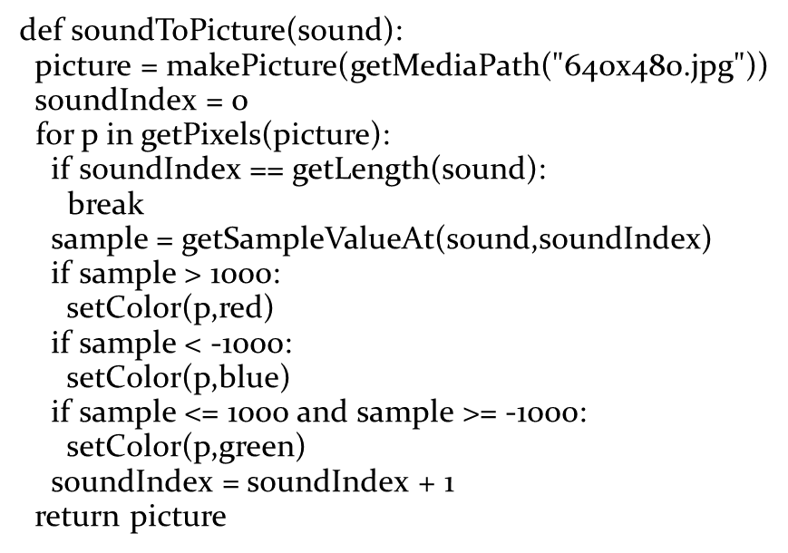
We Simply Decide on a Representation: How Do We Map Sample Values to Colors?
Here’s one:
Greater than 1000 is red
Less than 1000 is blue
Everything else is green

Slide 44
Break
break is yet another new statement.
It literally means “Exit the current loop.”
It’s most often used in the block of an if
“If something extraordinary happens, leave the loop immediately.”
In this case, “If we run out of samples before we run out of pixels, STOP!”

Slide 45

Representing “This is a Test”

Slide 46

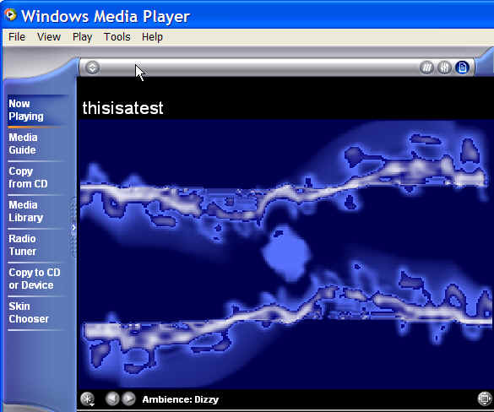
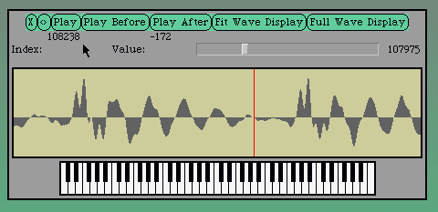
Any Visualization of Sound is Merely an Encoding

Slide 47
Any Visualization of Any Kind is Merely an Encoding
A line chart? A pie chart? A scatterplot?
These are just lines and pixels set to correspond to some mapping of the data
Sometimes data is lost
Recall the mapping of grayscale
Sometimes data is not lost, even if it looks like a dramatic change.
Recall creating a negative of an image, then taking the negative of a negative to get back to the original.

Slide 48
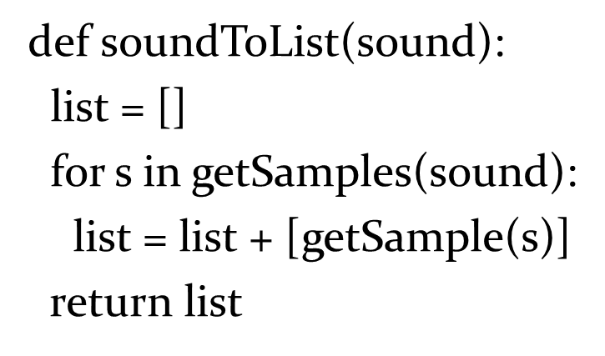
Lists Can Do Anything!
Going from sound to lists is easy:

Slide 49
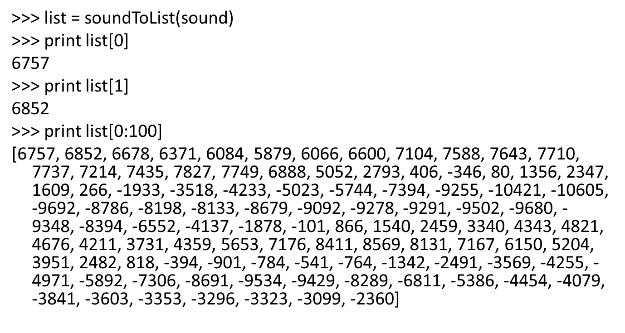
This Really Does Work

Slide 50
Can We Go from Pictures into Lists?
Of course! We just have to decide on a representation.
We’ll put a list as an element for each pixel.
The numbers in the pixel-list will represent
The X and Y positions
The Red, Green, and Blue component values.

Slide 51
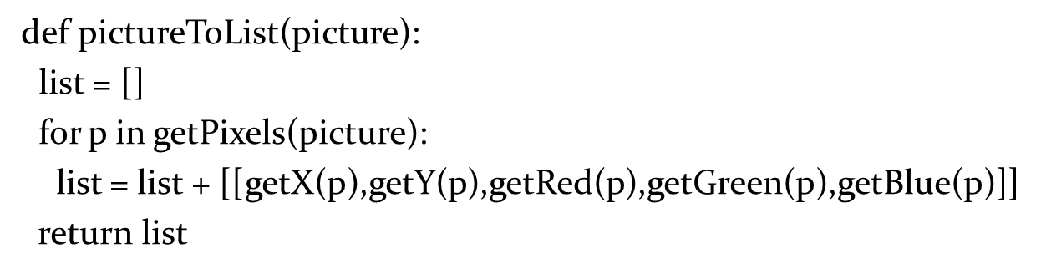
Pictures to Lists
Why the double brackets? Because we’re putting a sub-list in the list, not just adding a component as we were with sound.

Slide 52
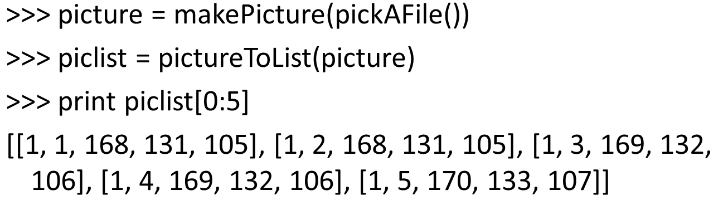
Running PictureTolist

Slide 53
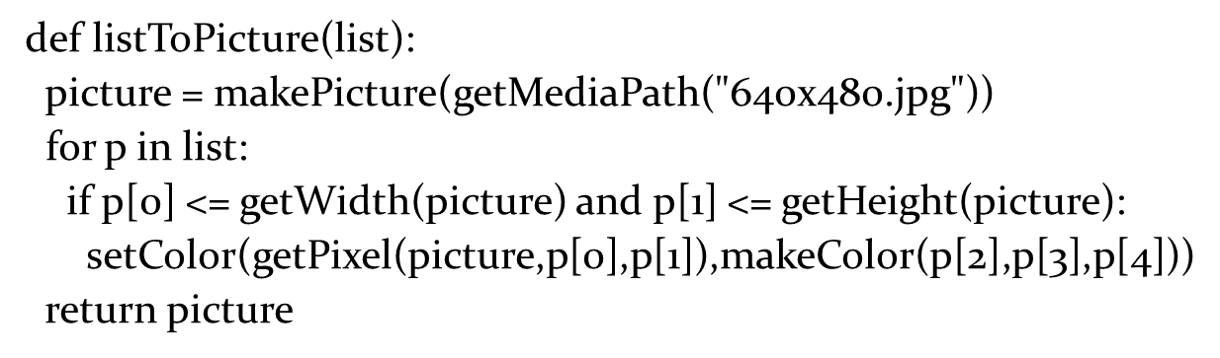
Can We Go Back Again? Sure!
We need to make sure that the X and Y fits within our canvas, but other than that, it’s pretty simple code.

Slide 54
The Numbers Could Have Come from Anywhere
The numbers in the list came from another picture, but we know that they could have come from anywhere!
From multiple sounds, one for each of Red, Green, and Blue.
From random numbers.
From stock market data.
From solar radiation.

Slide 55
All We’re Doing is Changing Encodings
The basic information isn’t changing at all here.
What’s changing is our encoding.
Different encodings afford us different capabilities.
If we go to numbers, we can use Excel.
If we go to lists, we can represent structure more easily.

Slide 56
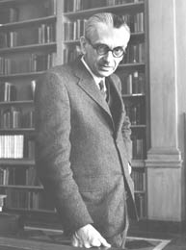
Kurt Gödel
One of Time magazine’s 100 greatest thinkers of the 20th century
Proved the “Incompleteness Theorem”
By mapping mathematical statements to numbers, he was able to show that there are true statements (numbers) that cannot be proven by any mathematical system.
Gödel numbers
In this way, he showed that no system of logic can prove all true statements.

Slide 57
Hiding Text in a Picture
Steganography is hiding information in ways that can’t be easily detected.
One form of steganography is hiding text information of a picture.

Slide 58
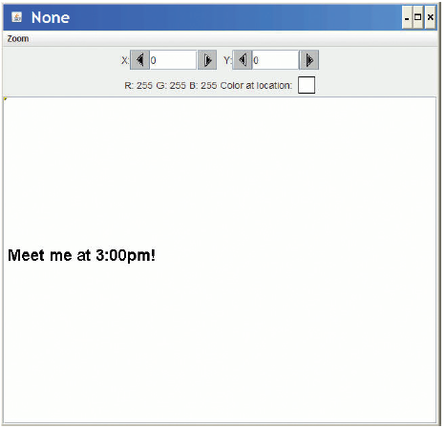
Our Algorithm for Hiding Text
We’ll draw our message in black pixels on a message picture.
We’ll hide our message in a picture of the same size.
First: Make sure that all red values are even.
Second: For every pixel where the message picture is black, add one to the red value at the corresponding x,y.

Slide 59
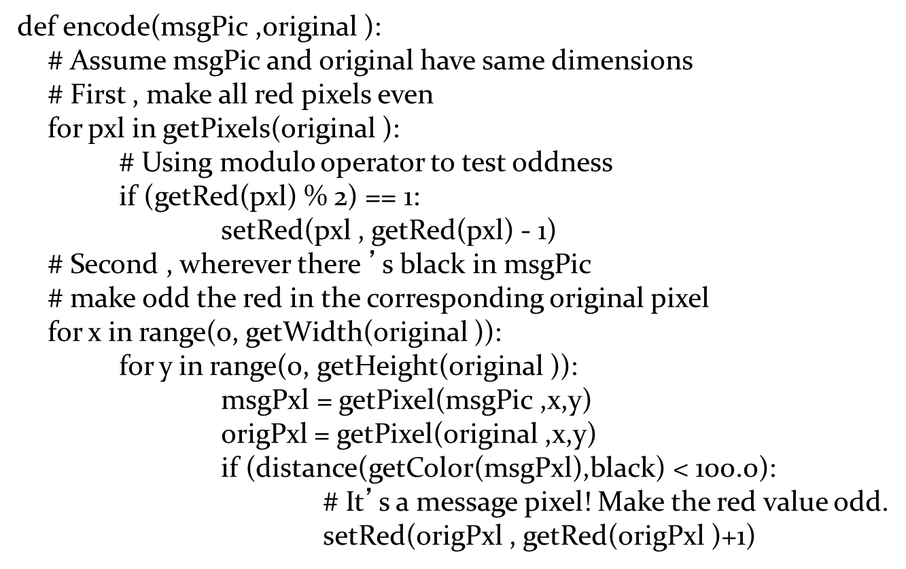
Function to Encode the Message

Slide 60
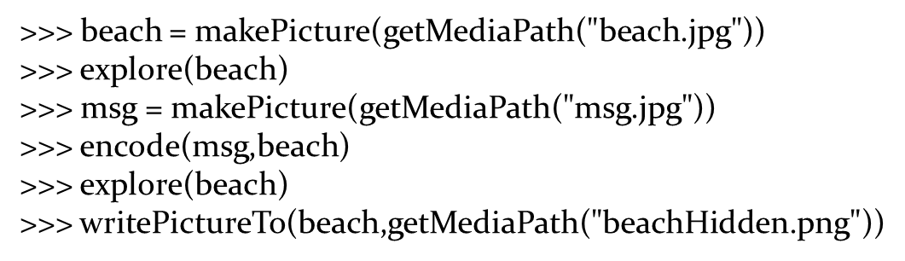
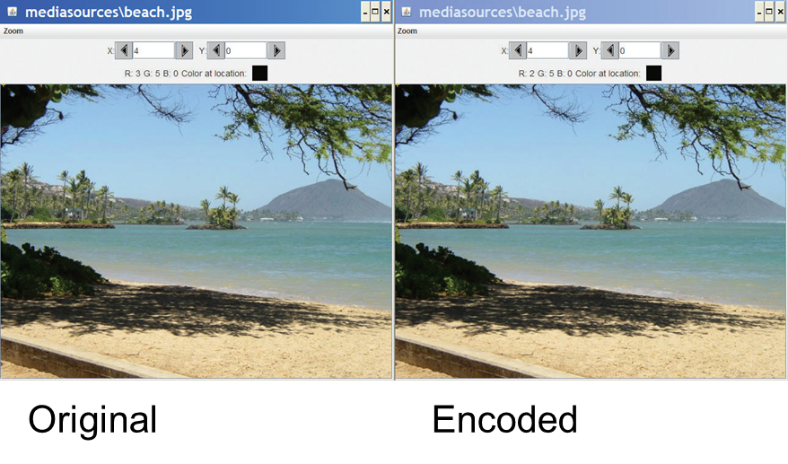
Doing the Encoding
It’s really important to save the message as .P N G or .B M P, not J P E G. J P E G is lossy so pixel color values might change. P N G and B M P are lossless formats.

Slide 61
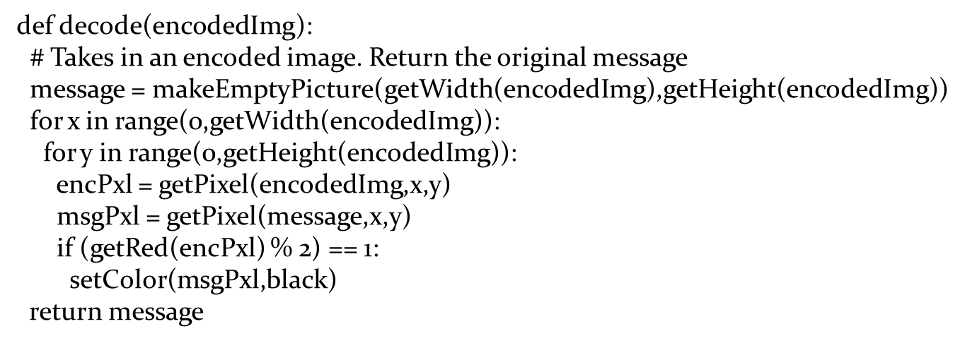
Decoding: Getting the Message Back
Create a new “message” picture of same size as the encoded image.
For each pixel, if the red value is odd, make the pixel in the message at the same x,y black.

Slide 62
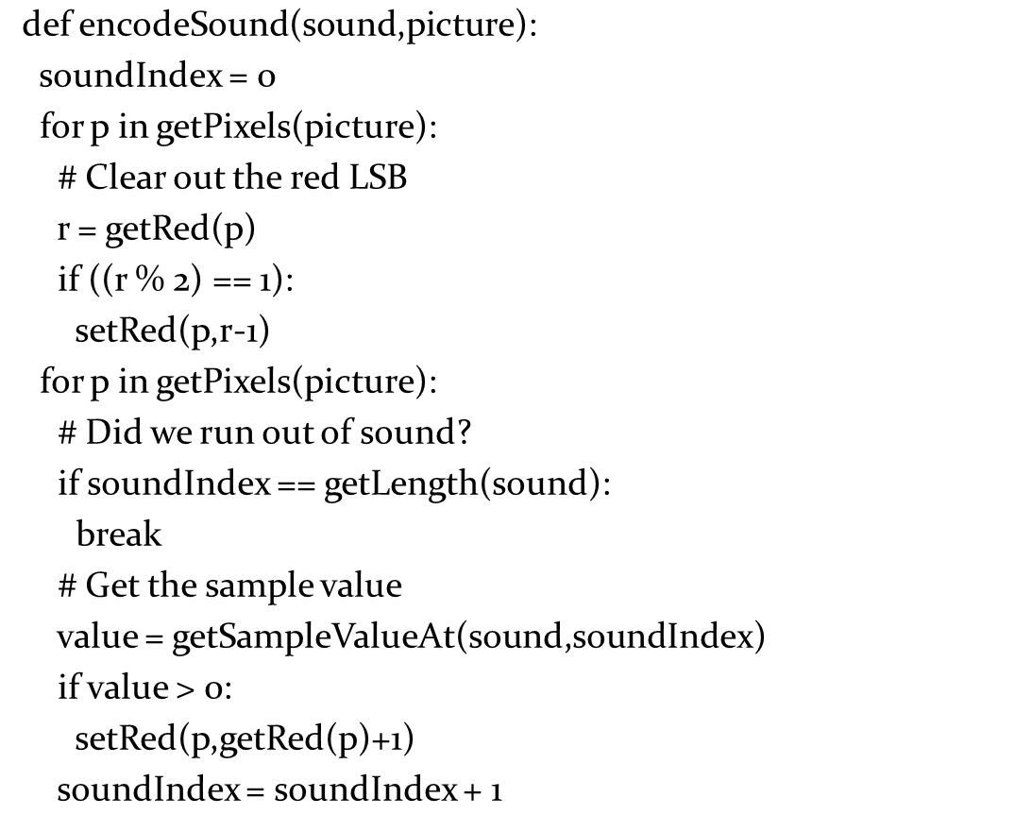
Encoding Sound in a Picture

Slide 63
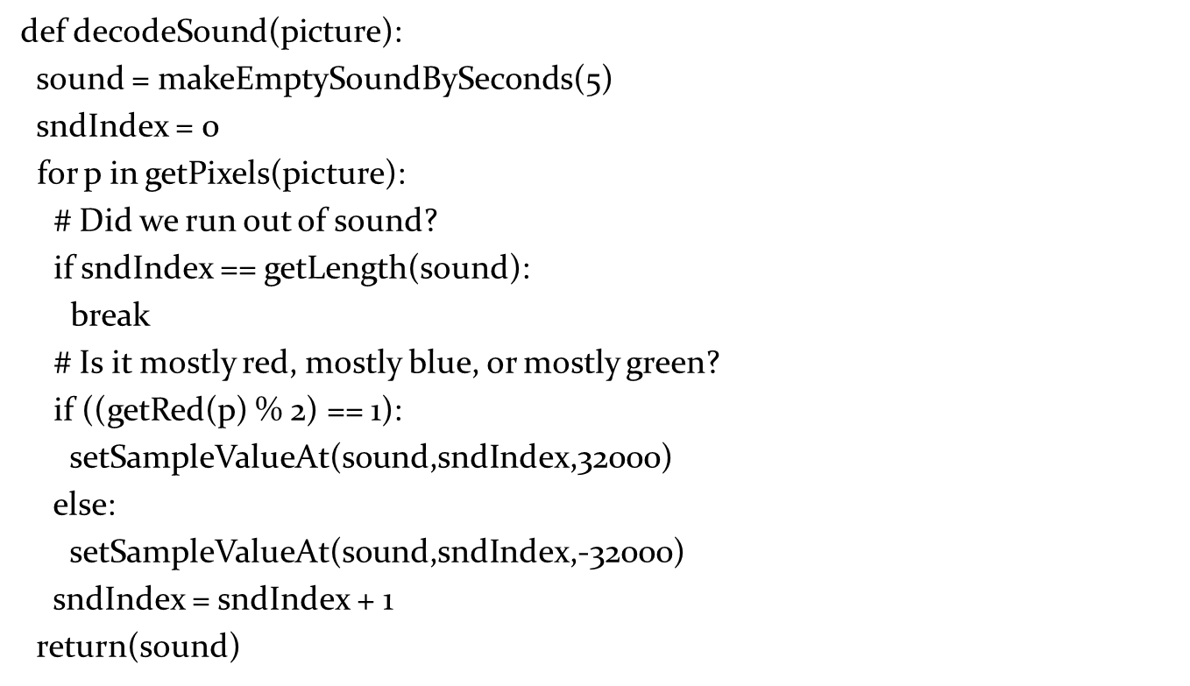
Decoding Sound from a Picture

Slide 64

Copyright

